Slide 1
Role of the Teaching-Learning Relationship in Building A Healthy Community A Way to Advance Health Equity and Providing the Opportunity for Everyone to Thrive
Edward P. Ehlinger, MD, MSPH
Commissioner, Minnesota Department of Health
April 27, 2017

Slide 2
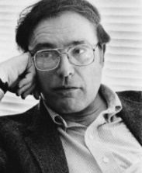
Gian-Carlo Rota born on April 27, 1932
Mathematician, philosopher and author credited with bringing combinatorics from obscurity to prominence.
“Every lecture should state one main point and repeat it over and over, like a theme with variations. An audience is like a herd of cows, moving slowly in the direction they are being driven towards. If we make one point, we have a good chance that the audience will take the right direction; if we make several points, then the cows will scatter all over the field. The audience will lose interest and everyone will go back to the thoughts they interrupted in order to come to our lecture.”

Slide 3
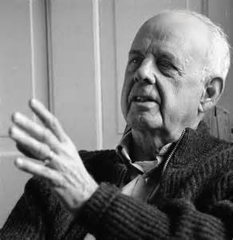
My One Main Point
“…the community in the fullest sense is the smallest unit of health…to speak of the health of an isolated individual is a contradiction in terms.”
Wendell Berry in Health is Membership

Slide 4
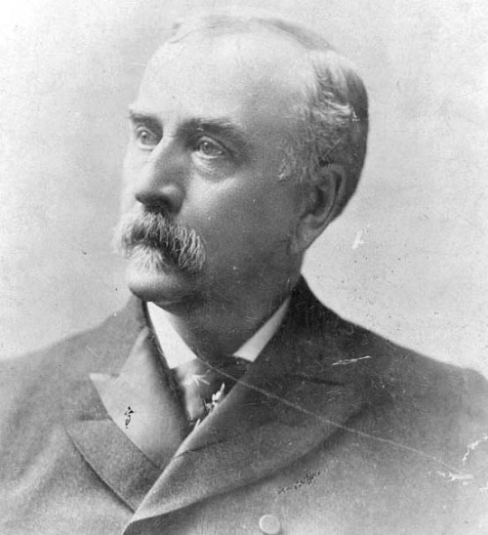
Julius Sterling Morton died on April 27, 1902
“Arbor Day (tomorrow) is not like other holidays. Each of those reposes on the past, while Arbor Day proposes for the future.”
“Each generation takes the earth as trustees. We ought to bequeath to posterity as many forests and orchards as we have exhausted and consumed.”
Julius Sterling Morton
Founder of Arbor Day
April 22, 1832 – April 27, 1902

Slide 5
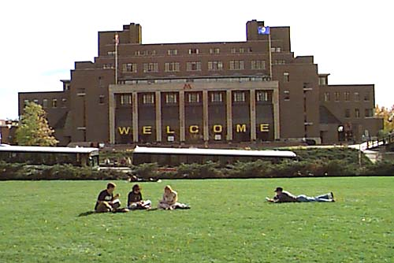
College Students Have Not Been a Public Health Priority
Well educated
Low levels of poverty
Overall healthy
Low death rate
Low birth rate

Slide 6
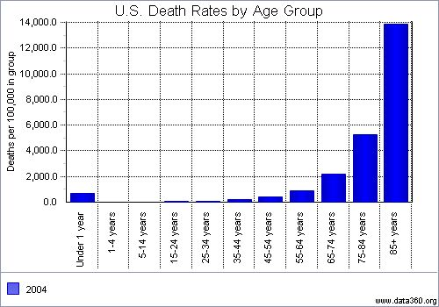

Slide 7
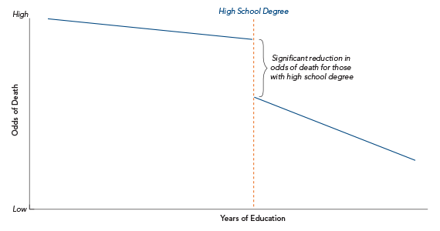
Relationship Between Educational Attainment and Mortality for U.S. Adults
Source: Jennifer Karas Montez et al., "Educational Attainment and Adult Mortality in the United States: A Systematic Analysis of Functional Form," Demography 49, no. 1 (2012): 315-36..

Slide 8
U.S. Birth Rates by Age – 2005 (Number of births/1,000 women in specific age range)
* = fertility rate/birth rate (# of births to all women/1,000 women age 15-44)

Slide 9
College Students Should Be A Long-term Public Health Priority Group
They are at a stage in life where they are establishing/solidifying lifestyle patterns.
They are society’s future leaders
They are trend setters of social norms.
They are role models for future generations.
Many will soon become parents.

Slide 10
College Students Should Be A Long-term Public Health Priority Group
Numbers are large and increasing
There are 4,182 colleges and universities in the United States.
~ 20 million people are enrolled in college. More than in high schools.
Over 2/3 of high school graduates enroll in college.
College is our “last best chance” to influence their development.
How can/should we do that?

Slide 11
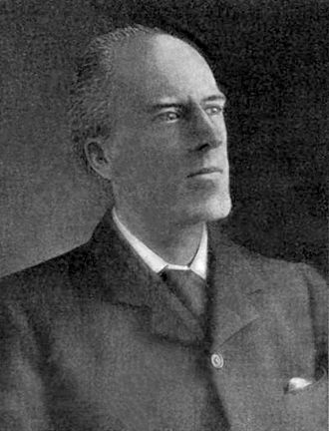
Karl Pearson died on April 27, 1936
Mathematician and biostatistician credited with establishing the discipline of mathematical statistics.
Founded the world's first university statistics department at University College London in 1911,
“All great scientists have, in a certain sense, been great artists; the man with no imagination may collect facts, but he cannot make great discoveries.”
Imagine how can you help create health on this campus and in the broader community.

Slide 12
What is health?
"Health is a state of complete physical, mental and social well-being and not merely the absence of disease or infirmity…a resource for everyday life, not the objective of living…emphasizing social and personal resources, as well as physical capacities."
WHO 1948 & Ottawa Charter for Health 1986
The opportunity to be healthy is not available everywhere or for everyone in Minnesota.

Slide 13
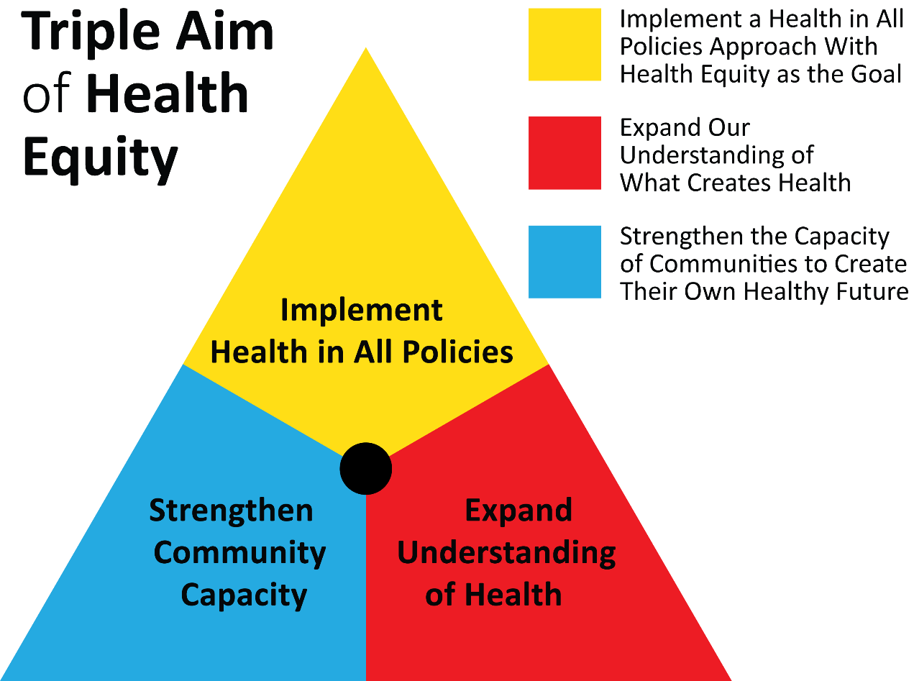
Creating Health and Health Equity is Complex – Who Knew? Complex or “Wicked” Problems Require Simple Rules
Social
Cohesion

Slide 14
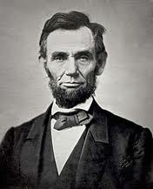
Expanding Our Understanding About What Creates Health Importance of Narrative
“Public sentiment is everything. With public sentiment, nothing can fail; without it nothing can succeed. Consequently he who molds public sentiment, goes deeper than he who enacts statutes or pronounces decisions. He makes statutes and decisions possible or impossible to be executed.”
-Abraham Lincoln

Slide 15
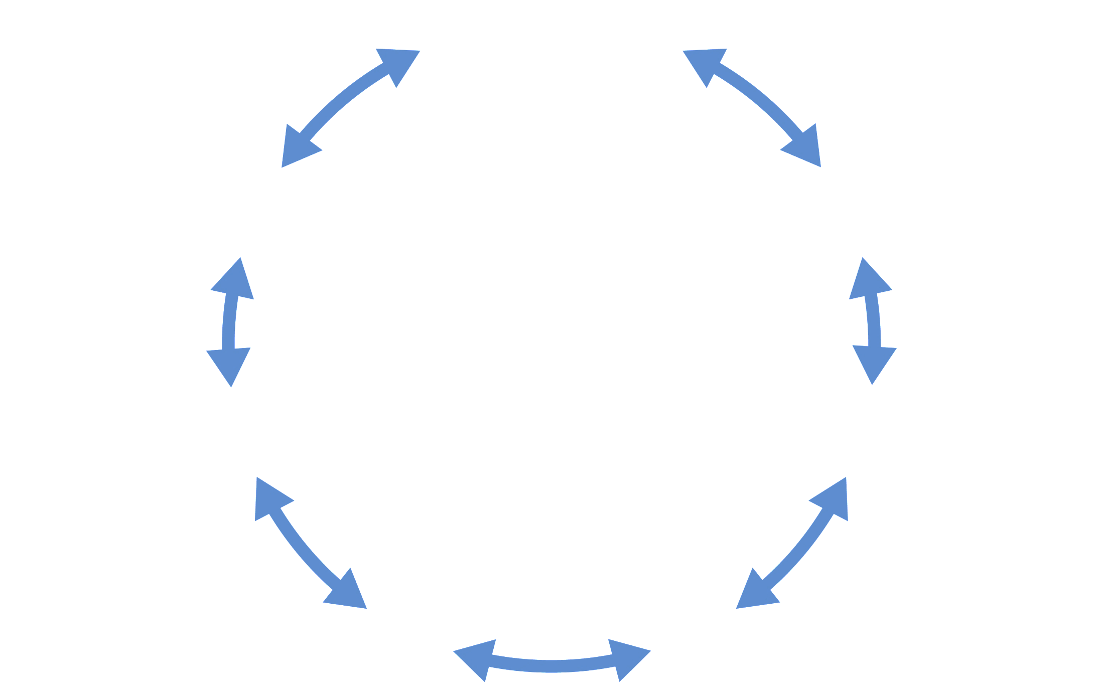
What’s the Dominant Narrative Today?
Predominant
U. S. Worldview
Boot Straps Individualism
Virtue of Work
Small Government
Free Market Solutions
Decreased investment in the “commons” and the disadvantaged
Increased competition & polarization
Over investment in biomedical model
Mistrust of
Science
Education is for job training
Reliance on technology/specialization
Structural Discrimination is a thing of the Past
Notes:
Here are a few narratives shaping public policy and decisions for the past 30-40 years; there are others but these keep coming up.
READ through the dominant narratives
These are not right or wrong, but they can influence how people think about health so it is important to understand them.
Does anyone have an example of how these work in your states or communities?
What is resonant in this story – even if you don’t agree with it – point out some underlying values/beliefs that many of us hold – the difference is in how they are woven together and lifted up. These are powerful -- That is actually the power of public narrative.
There are many definitions of power but the one we use here is from Martin Luther King, Jr.
[CLICK]
For those of you not used to thinking in terms of power, being unconscious of power – who has it, etc – is the same as ceding power or accepting the relationships of power that exist

Slide 16
Expand the Understanding About What Creates Health. The Dominant Narrative is:
People would be healthy if they worked hard; made good choices about diet, physical activity, and substance use; and had good medical care.
Health is the responsibility of individuals until they get sick, then it becomes the responsibility of the healthcare system.

Slide 17
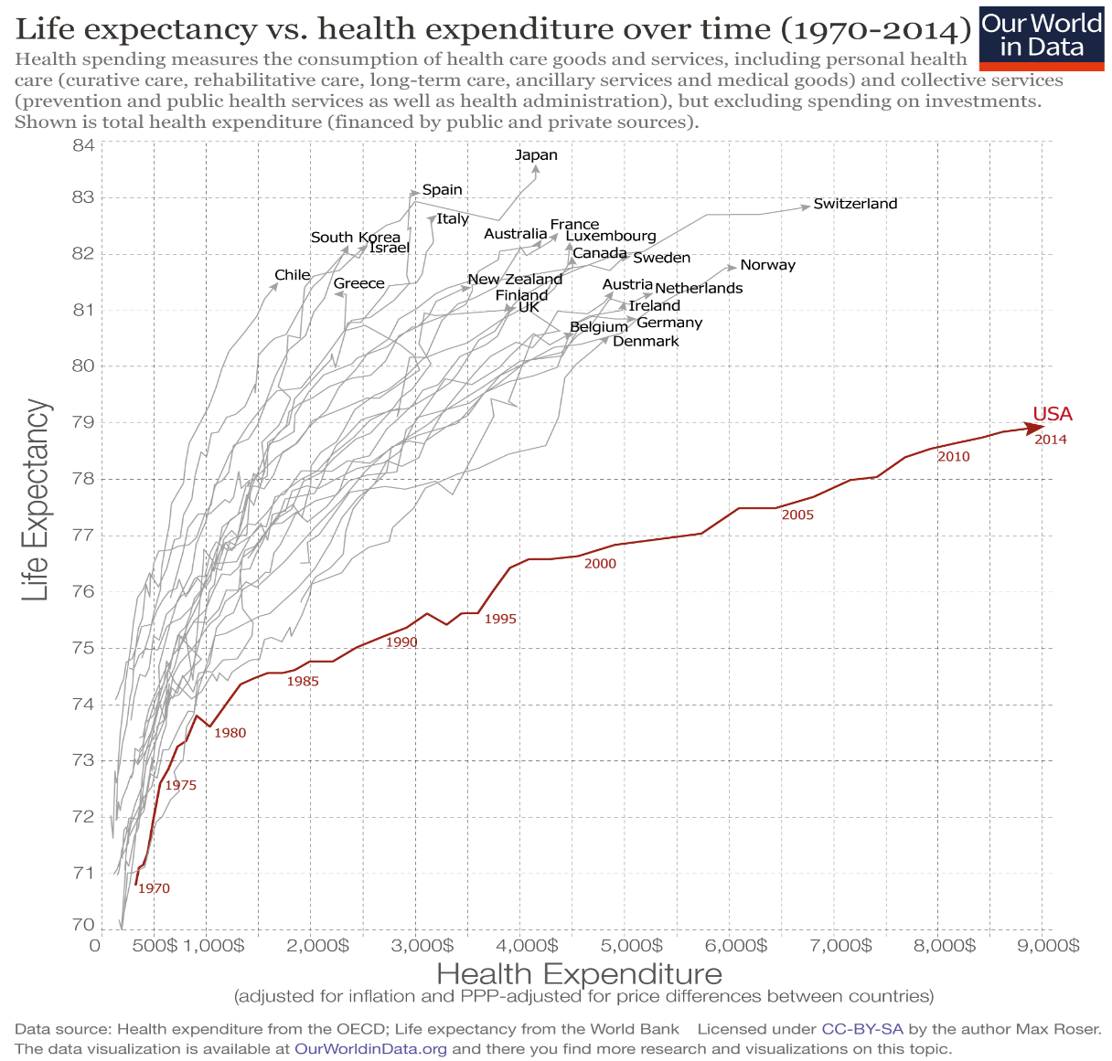
Life expectancy vs health expenditures - U.S. and OECD Countries 1970 - 2014
Health is not about healthcare investments

Slide 18
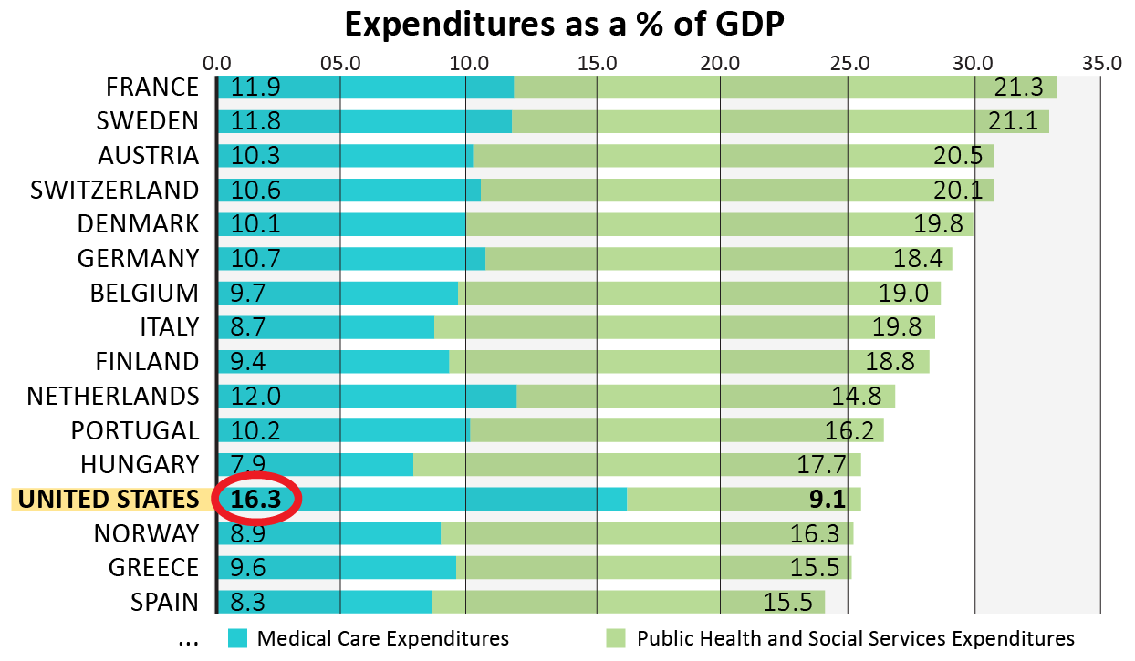
Total Investment in Health and Human Services
In OECD, for every $1 spent on health care, about $2 is spent on social services.
In the U.S., for every $1 spent on health care, about 55 cents is spent on social services.

Slide 19
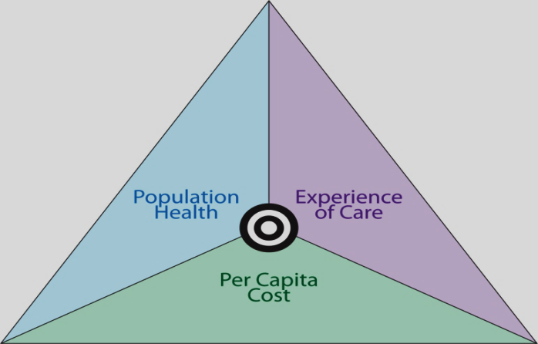
Triple Aim of Healthcare
Better care for individuals
Lower per capita costs
Better health for populations

Slide 20
The Triple Aim of Healthcare has not moved us to better health or health equity
Individual health model – not a community health model
What’s good for healthcare may not be what’s best for communities or advancing health equity
Reinforces the narrative about what creates health
Makes healthcare the benevolent dictator of health
Notes:
What’s good for health care
Critical access hospitals, primary care, community benefit programs
Healthcare benign dictator
All of health is viewed through the lens of healthcare
Assumes healthcare is responsible for population health
Healthcare dictates where health investments are made

Slide 21
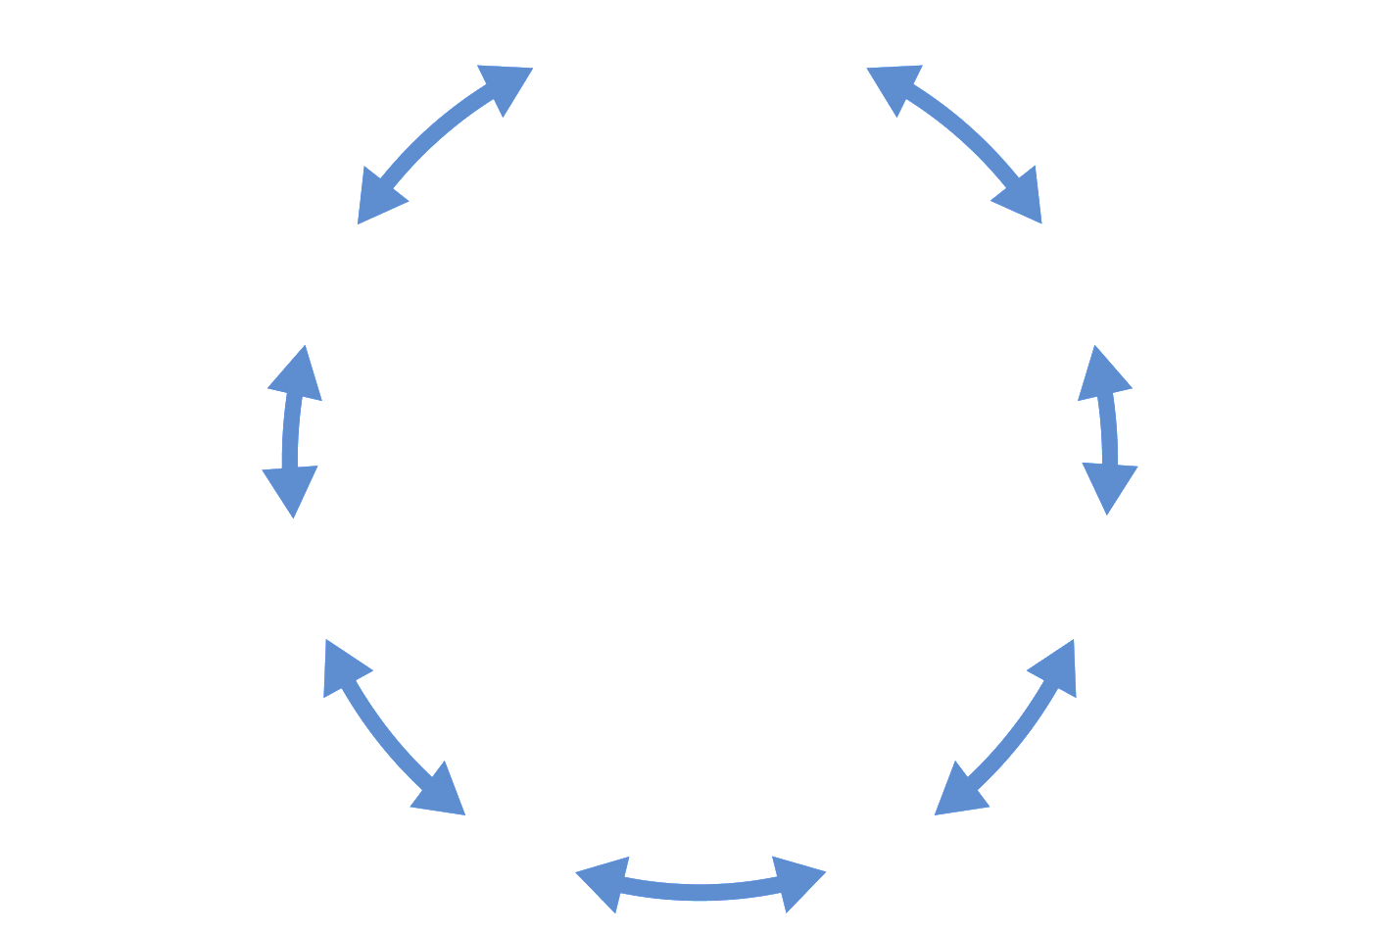
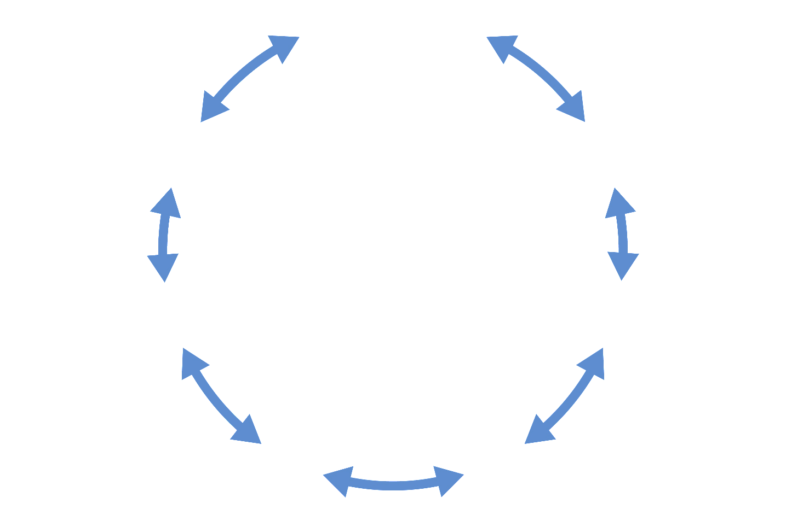
Contrasting/Alternative Worldviews
Interdependence
Social Cohesion
Virtue of Work
Boot Straps Individualism
Virtue of Work
Small Government
Free Market Solutions
Necessary government
Social responsibility
Social Justice
Dominant
U. S. Worldview
Alternative Worldview
Education is for job training
Cooperation
Collective Action
Education is for enlightenment
Mistrust of
science
Structural discrimination
is a thing of the past
Need for generalists
Equity is the challenge
of the present
Reliance on technology/specialization

Slide 22
Expand the Understanding of What Creates Health
Necessary conditions for health (WHO)
Peace
Shelter
Education
Food
Income
Stable eco-system
Sustainable resources
IT connectivity
Mobility
Health Care
Social responsibility
Social justice and equity
Determinants of Health
Genes and Biology
Social and Economic Factors
Physical Environment
10%
10%
40%
Clinical Care
10%
30%
Health Behaviors
Determinants of Health Model based on frameworks developed by: Tarlov AR. Ann N Y Acad Sci 1999; 896: 281-93; and Kindig D, Asada Y, Booske B. JAMA 2008; 299(17): 2081-2083.
World Health Organization. Ottawa charter for health promotion. International Conference on Health Promotion: The Move Towards a New Public Health, November 17-21, 1986 Ottawa, Ontario, Canada, 1986. Accessed July 12, 2002 at http://www.who.int/hpr/archive/docs/ottawa.html.

Slide 23
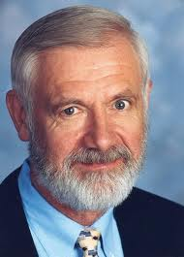
Social Justice is the basic philosophy of Public Health
“The philosophy behind science is to discover truth.
The philosophy behind medicine is to use that truth for the benefit of your patient.
The philosophy behind public health is social justice.”
William Foege – CDC director, 1977-1983

Slide 24
Communities of Opportunity
Low-Opportunity Communities
Social/economic exclusion
Few small businesses
Payday lenders
Few transportation options
Rental housing/foreclosure
Poor performing schools
Poor and limited housing stock
Increased pollution and contaminated drinking water
Fast food restaurants
Limited IT connections
Weak local governance
Unsafe/limited parks
Social/economic inclusion
Thriving small businesses and entrepreneurs
Financial institutions
Good transportation options and infrastructure
Home ownership
Better performing schools
Sufficient healthy housing
Grocery stores
IT connectivity
Strong local governance
Parks & trails
Good Health Status
Poor Health Status
Contributes to health disparities:
Diabetes
Cancer
Asthma
Obesity
Injury
Notes:
Communities influence SES
Maybe mention access to higher education (the health of the MNSCU system is important to the health of rural communities)
Locally driven financial institutions are important
Local control is important
http://www.cfra.org/community-development

Slide 25
HOUSEHOLD DYSFUNCTION
Divorce
Separation
Alcoholism
Drug use
Incarceration
Mental illness
Domestic violence
ABUSE/NEGLECT
Physical
Sexual
Emotional
Verbal
Death
Early
Death
Disease,
Disability &
Social Problems
Adoption of
Health Risk Behaviors
Social, Emotional, and
Cognitive Impairment
Disrupted Neurodevelopment
Conception
Adverse Childhood Experiences
Adverse Childhood Experiences influence health and well-being
throughout the lifespan

Slide 26
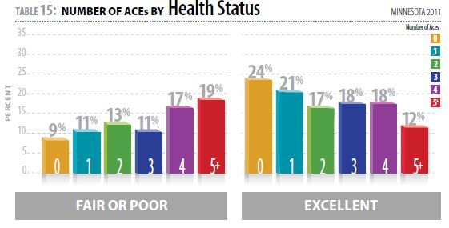

Slide 27
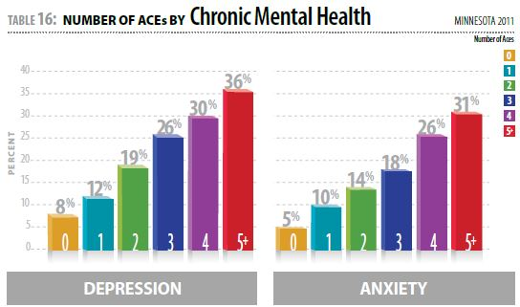

Slide 28
Adverse Childhood Experiences (ACEs) among MN college students Association Mean Number of Days of Poor Mental Health (undergraduates)
Number of ACEs
Poor days of health based on past 30 days
Notes:
Males:
[F(5,2693)=34.745], p=0.0001
Females:
[F(5,5669)=84.996], p=0.0001

Slide 29
ACE Score and Alcoholism, Suicide Attempts, or Sexual Assault
Notes:
3

Slide 30
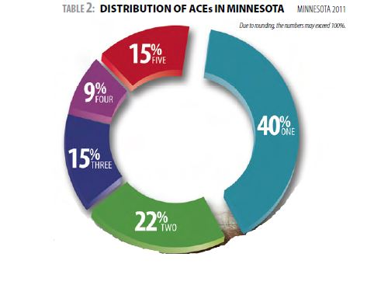
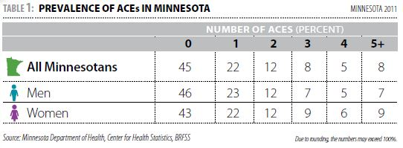

Slide 31
Adverse Childhood Experiences (ACEs) Distribution among MN college students
Notes:
Post-hoc analysis: (Bonferroni)
Undergraduate statistically different than graduate and Non-degree.
Graduate and Non-degree not statistically different.

Slide 32
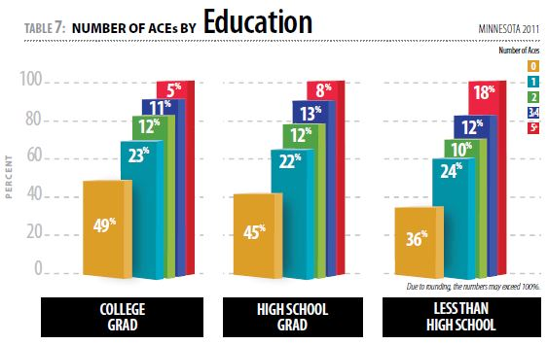

Slide 33
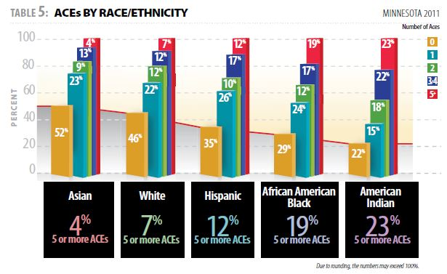

Slide 34
Ehlinger’s beliefs about the contributions to health determinants
Expand the Understanding of What Creates Health
Genes and Biology
Social and Economic Factors
Physical Environment
Determinants are created & enhanced mostly by policies and systems that impact the physical and social environment
10%
10%
Clinical Care
10%
60%
10%
Health Behaviors

Slide 35
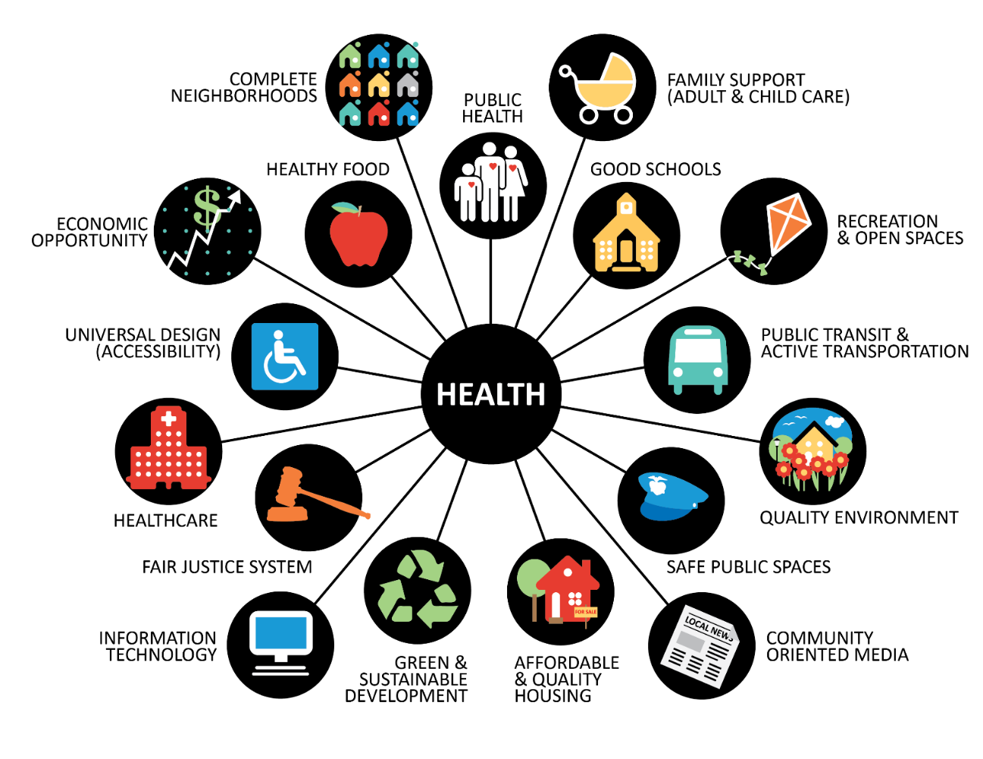
Implement a Health in All Policies Approach
with Health Equity as the Goal
Minimum Wage
Paid Leave
Criminal justice
Ban the Box
Transportation Policy
Broadband connectivity
E-Health Policies
Housing/Homelessness
Air/Water quality
Ag Buffer strips
Food Charter
Marriage Equity
Payday Lending
Freedom to Breathe
Health Care Reform

Slide 36
Implement Health in All Policies Approach with Health Equity as the Goal
Universities
Teachers
Commission on Social Determinants of Health. (2010). A conceptual framework for action on the social determinants of health. Geneva: World Health Organization.
Notes:
Strategies that alter social stratification
Strategies that decrease people's exposure to health damaging factors
Strategies that decrease the vulnerability and increase the resiliency of disadvantaged groups
Strategies that intervene through the health care delivery system to reduce the differential consequences of ill health
Talking Points:
This is the framework that the World Health Organization’s Commission on Social Determinants of Health first put out in 2007.
As with all models, this conceptual framework has both limitations and advantages, which we’ll go over.
But first, let’s take a few minutes to walk through it step-by-step, because, admittedly, it is a very complex looking model with lots of arrows and boxes!

Slide 37
Land Grant Universities were created to address social issues to advance the public good.
The mission of Land Grant Universities: focus on practical academic disciplines to address issues created by changing economic conditions and social class.

Slide 38
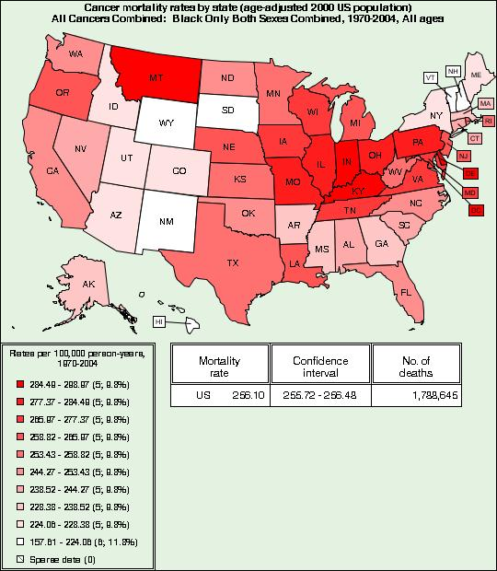

Slide 39
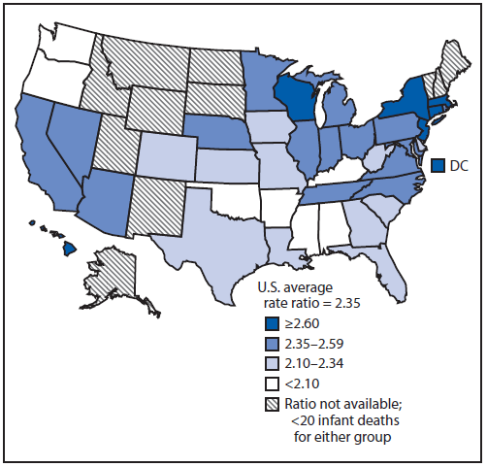
Ratio of non-Hispanic black and non-Hispanic white infant mortality rates,* by state — United States, 2006–2008
Source: National Vital Statistics System, NCHS, CDC

Slide 40
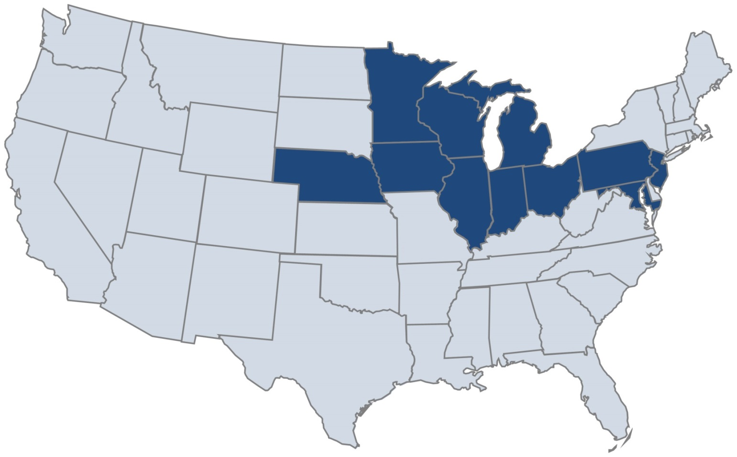
Big 10 Academic Alliance / State Health Department Health Equity Initiative
U of Minnesota
U of Iowa
U of Nebraska
U of Wisconsin
U of Illinois
Northwestern U
U of Chicago
Indiana U
Purdue U
Michigan State U
U of Michigan
Ohio State U
Penn State U
Rutgers U
U of Maryland

Slide 41
Strengthen the Capacity of Communities to Create Their Own Healthy Future Current Focus of Health Paradigm
Medical and Public Health Work
Traditional Public Health
Primary Prevention
Primary Care
Secondary Prevention
Specialty Care
Tertiary Prevention
MANAGEMENT OF RISKS & DISEASES
Milstein B. Hygeia's constellation: navigating health futures in a dynamic and democratic world. Atlanta, GA: Syndemics Prevention Network, Centers for Disease Control and Prevention; April 15, 2008. Available at: http://www.cdc.gov/syndemics/monograph/index.htm

Slide 42
Expanded Focus of Health Work Treatment, Prevention, Building Community Resilience
Healthy Public Policy & Public Work
Community Primary Prevention
Health Promotion
Medical and Public Health Policy
Traditional Public Health
Primary Prevention
Primary Care
Secondary Prevention
Specialty Care
Tertiary Prevention
DEMOCRATIC SELF-GOVERNANCE
Improving Living Conditions
MANAGEMENT OF RISKS & DISEASES
Milstein B. Hygeia's constellation: navigating health futures in a dynamic and democratic world. Atlanta, GA: Syndemics Prevention Network, Centers for Disease Control and Prevention; April 15, 2008. Available at: http://www.cdc.gov/syndemics/monograph/index.htm

Slide 43
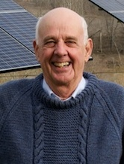
Strengthen the Capacity of Communities to Create Their Own Healthy Future
“We have lived by the assumption that what was good for us would be good for the world. We have been wrong. We must change our lives so that it will be possible to live by the contrary assumption, that what is good for the world will be good for us.”
Wendell Berry

Slide 44
Health is Community Social Cohesion
“A proper community…is a commonwealth: a place, a resource, an economy. It answers the needs, practical as well as social and spiritual, of its members - among them the need to need one another. Wendell Berry, The Art of the Commonplace: The Agrarian Essays

Slide 45
Variation on the theme Health is essential to the success of our society
“When health is absent, wisdom cannot reveal itself, art cannot become manifest, strength cannot fight, wealth becomes useless, and intelligence cannot be applied.”
Herophilus of Chalcedon, 335-280 BCE
Physician to Alexander the Great
Gary Hallmann

Slide 46
Variation on the theme The success of all sectors of our society is essential to our health
“Health is absent when wisdom cannot reveal itself, art cannot become manifest, strength cannot fight, wealth becomes useless, and intelligence cannot be applied.”
Ed Ehlinger, 12/10/2015 CE
Physician to the State of Minnesota
Gary Hallmann

Slide 47
Advancing Health Equity and Optimal Health for All

Slide 48
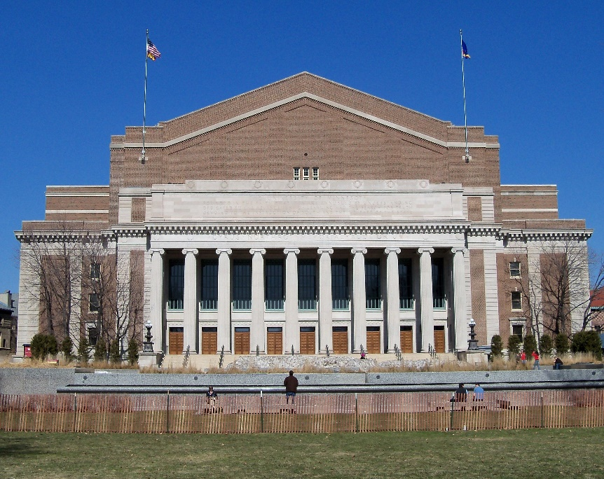
Inscription over Northrop Auditorium
The University of Minnesota:
Founded in the Faith that Men are Ennobled by Understanding;
Dedicated to the Advancement of Learning and the Search for Truth;
Devoted to the Instruction of Youth and the Welfare of the State."

Slide 49
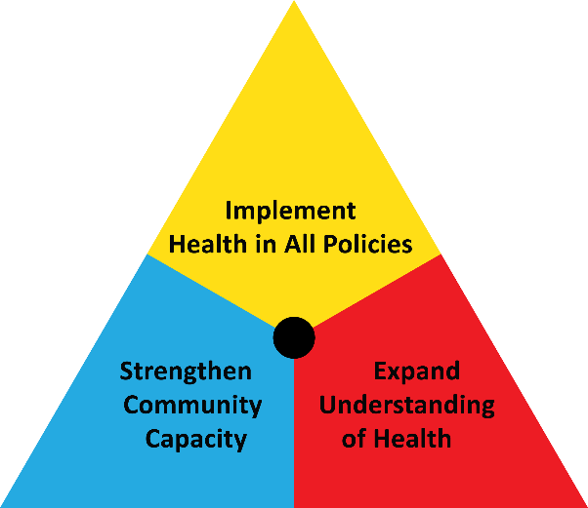
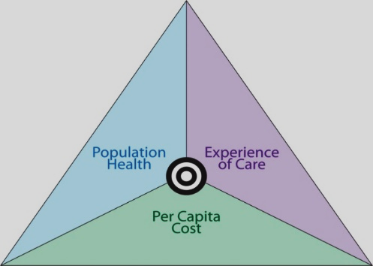
“We all do better when we all do better.” Senator Paul Wellstone
WHO Framework on Social Determinants of Health
Social
Cohesion
Edward P. Ehlinger, MD, MSPH Commissioner, MDH
President, ASTHO P.O. Box 64975 St. Paul, MN 55164-0975
Ed.ehlinger@state.mn.us
Notes:
Strategies that alter social stratification
Strategies that decrease people's exposure to health damaging factors
Strategies that decrease the vulnerability and increase the resiliency of disadvantaged groups
Strategies that intervene through the health care delivery system to reduce the differential consequences of ill health
Talking Points:
This is the framework that the World Health Organization’s Commission on Social Determinants of Health first put out in 2007.
As with all models, this conceptual framework has both limitations and advantages, which we’ll go over.
But first, let’s take a few minutes to walk through it step-by-step, because, admittedly, it is a very complex looking model with lots of arrows and boxes!

